Slide 1
Software Engineering & secure Coding
Injection attacks detection & prevention

Slide 2
What’s Injection attacks ?
During an injection attack, an attacker can provide malicious input to a web application (inject it) and change the operation of the application by forcing it to execute certain commands.
Injection attacks occurs due to missing input validation or sanitization

Slide 3
Types of Injection attacks
SQL and Cross-Site Scripting injection attacks are the most common types, there is a more host of injection attacks, all of which have different aims and means to achieving them.
The main types of injection attacks that your application may be vulnerable to are:
XSS (Cross-Site Scripting)
SQL injection

Slide 4
SQL injection
SQL injection is a web security vulnerability that allows an attacker to interfere with the queries that an application makes to its database.
It generally allows an attacker to view data that they are not normally able to retrieve.
This might include data belonging to other users, or any other data that the application itself is able to access.
In many cases, an attacker can modify or delete this data, causing persistent changes to the application's content or behavior.

Slide 5
Impact of SQL injection attack
A successful SQL injection attack can result in unauthorized access to sensitive data, such as passwords, credit card details, or personal user information.
Many high-profile data breaches in recent years have been the result of SQL injection attacks, leading to reputational damage and regulatory fines.
In some cases, an attacker can obtain a persistent backdoor into an organization's systems, leading to a long-term compromise that can go unnoticed for an extended period.

Slide 6
we can gain from SQL injection more scenarios such as:
Retrieving data using SQLMAP tool
Bypass Authentications
Examining the database

Slide 7

Here is an example with Vulnerable Code for SQL injection attack
And we will discuss how to exploit this vulnerability and steps for exploitation.
Also, introducing the mitigation techniques.
In this example is a simple function that’s takes the id of users and returns the user details. This function possibly vulnerable to SQL injection

Slide 8
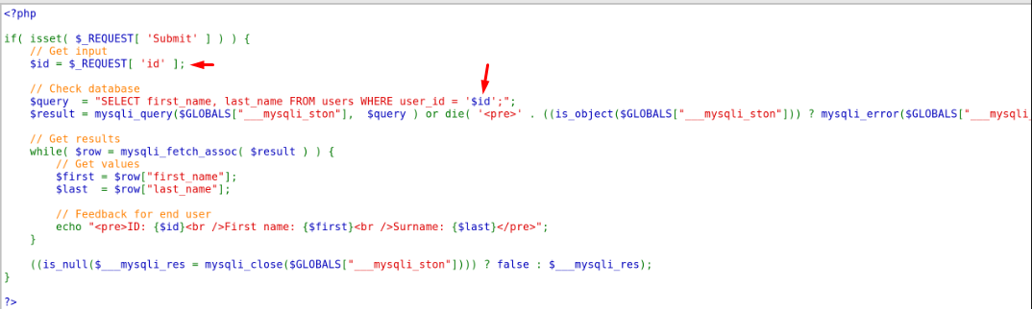
If we look at the source code
We will find that the ID parameter (which is controlled by end user)
Reflected in SQL Query. due this we can manipulate this query to retrieve any data from our database. If any protection layer is not applied

Slide 9
We can force the SQL query to be a True condition any by put in the parameter SQL Syntax instead of the user ID such as
‘ OR 1=1--
By that we can force the query to return true condition and retrieve the data from the database without knowing the ID of the user
First single for closing the ID string in the qurey
OR is a SQL operator
1=1 Any values that give a true condition
-- To make a comment for the rest of the query

Slide 10
The same concept is used for breaking authentication mechanisms
look, if we put our username and password in any web app to login
Sometimes our submitted data reflected in SQL query for query database and make validation if these data is exist or not.
Due this we can manipulate this query and authenticate without knowing the password or username
SELECT * WHERE username=ahmed AND password=123456
The same concept we can manipulate this query If any protection layer is not applied

Slide 11
SELECT * WHERE username=ahmed AND password=123456
SELECT * WHERE username=ahmed-- AND password=123456
By using -- we commented the red section in the query and by that we able to authenticate without knowing the password.

Slide 12
Mitigation of SQL injection
We can mitigate SQL injection attacks by using more techniques
using mysqli_real_escape_sctring() PHP function to escaping any ‘
using str_replace() PHP function for data sanitization
using Prepared statements

Slide 13
XSS
XSS is a web security vulnerability that allows an attacker to compromise the interactions that users have with a vulnerable application.
It allows an attacker to circumvent the same origin policy, which is designed to segregate different websites from each other. Cross-site scripting vulnerabilities normally allow an attacker to masquerade as a victim user, to carry out any actions that the user is able to perform, and to access any of the user's data.
If the victim user has privileged access within the application, then the attacker might be able to gain full control over all of the application's functionality and data.

Slide 14
Cross-site scripting works by manipulating a vulnerable web site so that it returns malicious JavaScript to users. When the malicious code executes inside a victim's browser, the attacker can fully compromise their interaction with the application.
You can confirm most kinds of XSS vulnerability by injecting a payload that causes your own browser to execute some arbitrary JavaScript. It's long been common practice to use the alert() function for this purpose because it's short, harmless, and pretty hard to miss when it's successfully called

Slide 15
Types of XSS attacks
There are three main types of XSS attacks. These are:
Reflected XSS, where the malicious script comes from the current HTTP request.
Stored XSS, where the malicious script comes from the website's database.
DOM-based XSS, where the vulnerability exists in client-side code rather than server-side code.

Slide 16
Reflected XSS is the simplest variety of cross-site scripting. It arises when an application receives data in an HTTP request and includes that data within the immediate response in an unsafe way.
Here is a simple example of a reflected XSS vulnerability:
https://vulnerable-website.com/status?message=<script>alert(1)</script>
Stored XSS (also known as persistent or second-order XSS) arises when an application receives data from an untrusted source and includes that data within its later HTTP responses in an unsafe way.
The data in question might be submitted to the application via HTTP requests; for example, comments on a blog post, user nicknames in a chat room, or contact details on a customer order. In other cases, the data might arrive from other untrusted sources; for example, a webmail application displaying messages received over SMTP, a marketing application displaying social media posts, or a network monitoring application displaying packet data from network traffic.

Slide 17
DOM-based XSS (also known as DOM XSS) arises when an application contains some client-side JavaScript that processes data from an untrusted source in an unsafe way, usually by writing the data back to the DOM.
In the following example, an application uses some JavaScript to read the value from an input field and write that value to an element within the HTML:
var search = document.getElementById('search').value;
var results = document.getElementById('results');
results.innerHTML = 'You searched for: ' + search;
If the attacker can control the value of the input field, they can easily construct a malicious value that causes their own script to execute:
You searched for: <img src=1 onerror='/* Bad stuff here... */'>

Slide 18
To Prevent XSS
Preventing cross-site scripting is trivial in some cases but can be much harder depending on the complexity of the application and the ways it handles user-controllable data.
In general, effectively preventing XSS vulnerabilities is likely to involve a combination of the following measures:
Filter input on arrival. At the point where user input is received, filter as strictly as possible based on what is expected or valid input.
Encode data on output. At the point where user-controllable data is output in HTTP responses, encode the output to prevent it from being interpreted as active content. Depending on the output context, this might require applying combinations of HTML, URL, JavaScript, and CSS encoding.
Use appropriate response headers. To prevent XSS in HTTP responses that aren't intended to contain any HTML or JavaScript, you can use the Content-Type and X-Content-Type-Options headers to ensure that browsers interpret the responses in the way you intend.
Content Security Policy. As a last line of defense, you can use Content Security Policy (CSP) to reduce the severity of any XSS vulnerabilities that still occur.

Slide 19
Exploiting XSS to Steal Cookies
What are Cookies?
While browsing the internet, chances are that you’ve came across pop-ups that ask if you want to allow cookies. Instead of questioning what cookies are, the average user accepts the cookies and continues shopping for the latest fashion. Cookies are essentially small text files that are stored on your computer’s hard drive. They contain information such as a token that validates your current session, shopping cart information, a unique ID, a site name, etc. They were originally created to maximize space on companies’ hard drives and to create a better browsing experience for the consumers.

Slide 20
Various types of cookies
There are three main types of cookies: Session, Persistent and Third-Party.
Session Cookies: Mostly used on e-commerce and shopping websites to help identify users and provide information about the user’s search history while on the website. Without these cookies, the website would have no way to remember what items you put inside your cart. These cookies are also called “Temporary Cookies” since the cookies are deleted once the user closes their web browser or logs out of the site.
Persistent Cookies: Also known as “Permanent Cookies” continue to operate even after the web browser closes. Persistent cookies are very similar to session cookies since they store the same type of information. The big difference with these cookies is that they retain information even after the website session has been closed. These cookies typically have an expiration date attached to them.
Third-Party Cookies: These cookies are created by websites that are not the website you’re currently visiting. They collect data on users and use the information to serve advertisements relevant to a customer’s searches and purchases on the site. Third-party cookies may potentially track users across many different websites by adding their tags to a page.

Slide 21
Exploiting cookies using XSS
When exploiting XSS, the first step is to identify a target that may have a Stored XSS vulnerability or reflected.
This could be done by going to the target’s website and turning on the interceptor in Burpsuite to intercept the HTTP requests and responses sent.
After examining the target’s website, we notice that there is a place to potentially insert a malicious script to steal a session cookie.

Slide 22
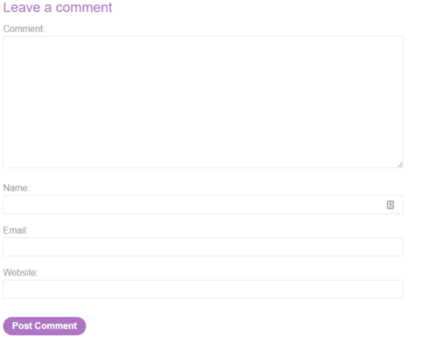
Functionality may be vulnerable to Stored XSS

Slide 23
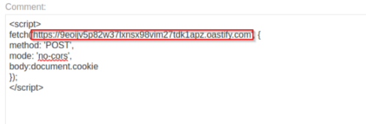
Suppose we have one parameter from these post parameters vulnerable to stored XSS.
How do we get the Cookies?
First, we need to host web app to receive data from the victim
Or use Burp Collaborator Client.
Secondly, we need to write the code that we inject into the site through the vulnerable parameter.
specified link is the attacker malicious web-site

Slide 24
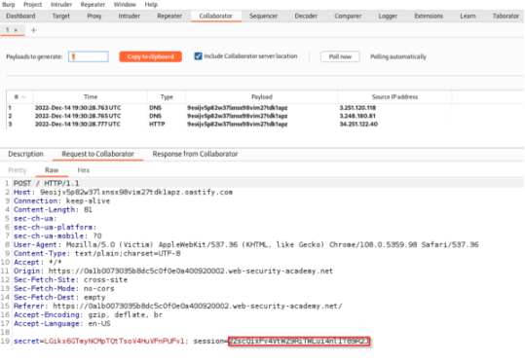
After that any user see our comment the script will execute and connected back to our malicious website sending us the cookies.
As you can see, the request body contains an object called document.cookie
Using document.cookie property we can sent, read and create cookiesin javascript
In our example we use it to get the cookies.
After execute the XSS payload by victim we will go to Burp Collaborator and see the captured request

Slide 25
As you can see in the request, it contains cookies for the victim, which is easy for us to take and log in with as if we were the victim.
Once sent, the session has successfully been stolen. We could then continue to browse the website while logged in as the victim for as long as this session token remains valid.

Slide 26
Protecting cookies against XSS using HTTPOnly Flag Set
The HttpOnly attribute is an optional attribute of the Set-Cookie HTTP response header that is being sent by the web server along with the web page to the web browser in an HTTP response. Here is an example of setting a session cookie using the Set-Cookie header:
HTTP/2.0 200 OK
Content-Type: text/html
Set-Cookie: sessionid=QmFieWxvbiA1
The session cookie above is not protected and can be stolen in an XSS attack. However, if the session cookie is set as follows, it is protected from being accessed using JavaScript:
Set-Cookie: sessionid=QmFieWxvbiA1; HttpOnly

Slide 27
How to Set HttpOnly Server-Side!
All modern back-end languages and environments support setting the HttpOnly flag.
Here is an example of how you can do this in PHP using the setcookie function:
setcookie("sessionid", "QmFieWxvbiA1", ['httponly' => true]);
The last value (true) represents setting the HttpOnly attribute.

Slide 28
Other Flags For Secure Cookies
The HttpOnly flag is not the only cookie security flag that you can use to protect your cookies. Here are two more that can be useful.
Secure Flag
The Secure flag is used to declare that the cookie may only be transmitted using a secure connection (SSL/HTTPS). If this cookie is set, the browser will never send the cookie if the connection is HTTP. This flag prevents cookie theft via man-in-the-middle attacks.
SameSite Flag
The SameSite flag is used to declare when web browsers should send the cookie, depending on how a visitor interacts with the site that set the cookie. This flag is used to help protect against cross-site request forgery (CSRF) attacks.

Slide 29
Are Cookie Flags Enough against XSS?
Even though cookie flags are effective for many attacks, they cannot be used as a remedy for cross-site scripting.
The only effective way to protect against cross-site scripting is to find such vulnerabilities in the application and eliminate them at the source. And the only effective way to find such vulnerabilities is by performing manual penetration testing

Slide 30
Same Origin Policy
The same-origin policy is a web browser security mechanism that aims to prevent websites from attacking each other.
The same-origin policy restricts scripts on one origin from accessing data from another origin. An origin consists of a URI scheme, domain and port number. For example, consider the following URL:
http://normal-website.com/example/example.html
The URL’s with the same protocol, domain name and same port are considered as same origin.

Slide 31
Why is the same-origin policy necessary?
When a browser sends an HTTP request from one origin to another, any cookies, including authentication session cookies, relevant to the other domain are also sent as part of the request. This means that the response will be generated within the user's session, and include any relevant data that is specific to the user. Without the same-origin policy, if you visited a malicious website, it would be able to read your emails from GMail, private messages from Facebook, etc.

Slide 32
How to allow cross-origin access
Use CORS to allow cross-origin access. CORS is a part of HTTP that lets servers specify any other hosts from which a browser should permit loading of content.
Access-Control-Allow-Origin: https://foo.example
The server respond with specified origin that’s allowed to bypass the Same origin policy
also the value of this header can be wildcard (*) which refers to allow all origins

Slide 33
example
http://testapp.com:80
http://testapp.com:80
http://testapp.com:80
These URL’s can be considered to be the same origin because they the same protocol, domain and port. Otherwise, they cannot be considered the same Origin

